Slide 1
MATH
Machine Learning
LAB 1
Bharuno Mahesworo

Slide 2
How to LAB?
Download this PPT
Follow the instruction
Screen shoot your code and its result of each instruction, then put it on the instruction slide.
Submit your slide deck and notebook file
Googling is permitted
Using Communication platform (email, discord, social media, etc.) is prohibited
Submit to:
bharuno.mahesworo@binus.ac.id
Before the end of the LAB.
Subject: ML_(class code)_(LAB session)_NIM
Example: ML_LZ99_LAB1_12345
File name format: ML_(class code)_(LAB session)_NIM
Example: ML_LZ99_LAB1_12345

Slide 3
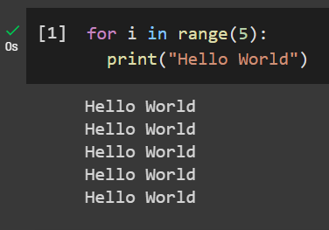
Print Hello World 5 times using loops
Example
Instruction
Your compiled codes
hint
for loops or while loops

Slide 4
LAB 1 – Classification Diabetes
The objective of the dataset is to diagnostically predict whether a patient has diabetes, based on certain diagnostic measurements included in the dataset. “diabetes.csv” can be downloaded from binusmaya
Target Variable
Outcome: 0 (no diabetes) or 1 (has diabetes)
Features
Pregnancies - Number of times pregnant
Glucose - Plasma glucose concentration
BloodPressure - Diastolic blood pressure (mm Hg)
SkinThickness - Triceps skin fold thickness (mm)
Insulin - 2-Hour serum insulin (mu U/ml)
BMI - Body mass index
DiabetesPedigreeFunction
Age

Slide 5
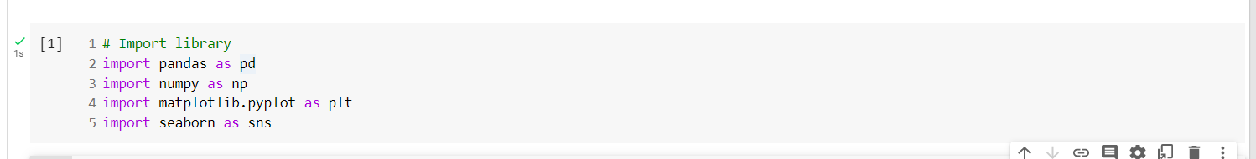
1. Import Standard Library (Pandas, Numpy, Matplotlib, Seaborn)

Slide 6
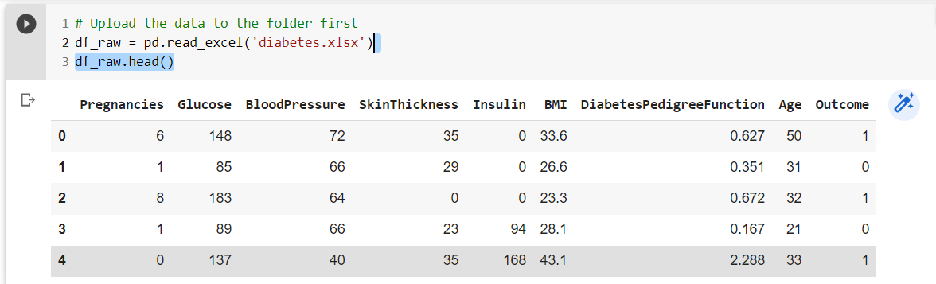
2. Import or Read “diabetes.csv” data into a DF variable with the name of “df_raw” then show its information and numerical descriptive data!
.info(), .describe()

Slide 7
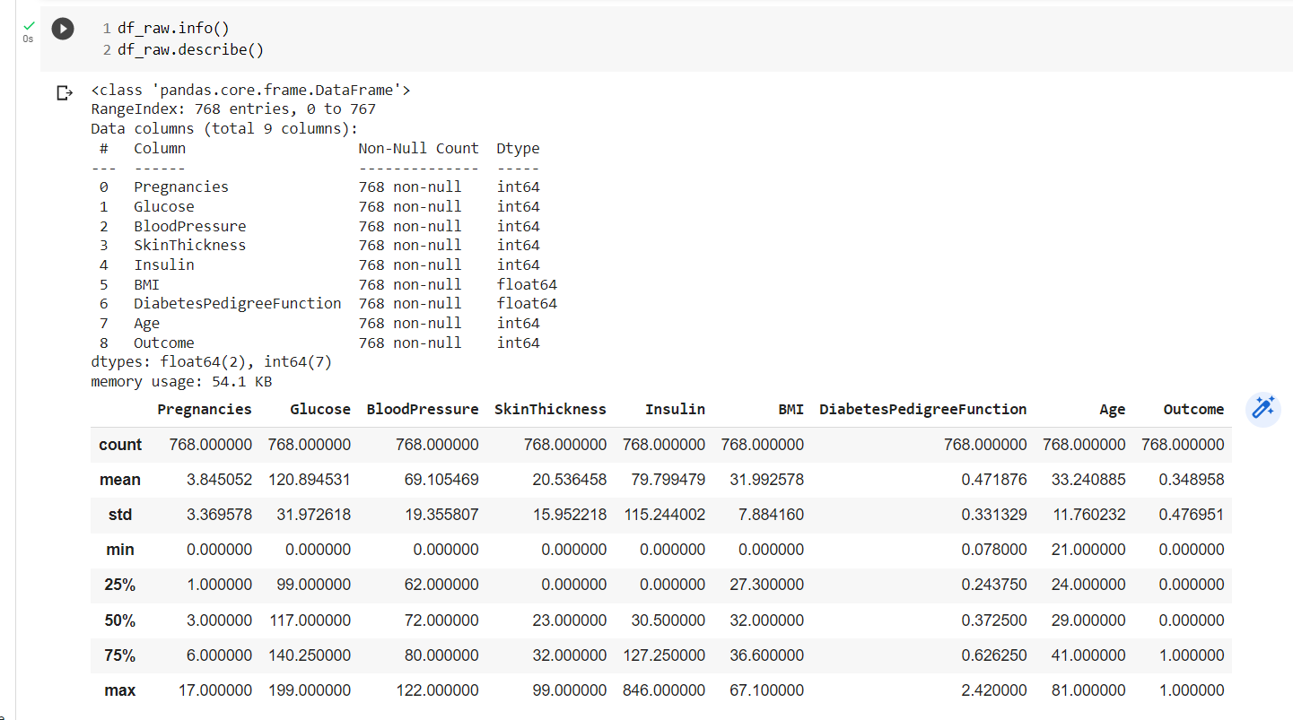
.info(), .describe()

Slide 8
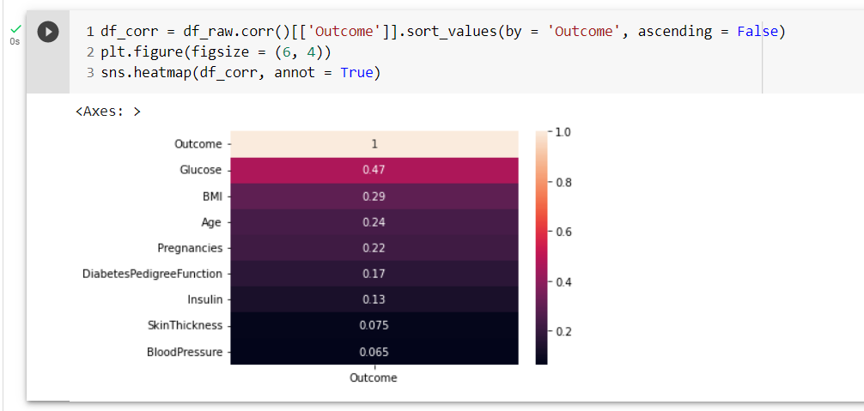
3. Create correlation heatmap that only show the correlation of all variables to “Outcome”
.heatmap(), .corr()

Slide 9
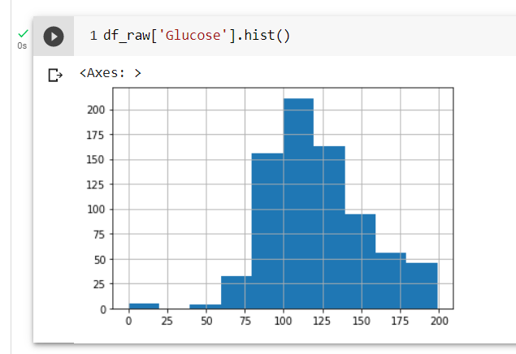
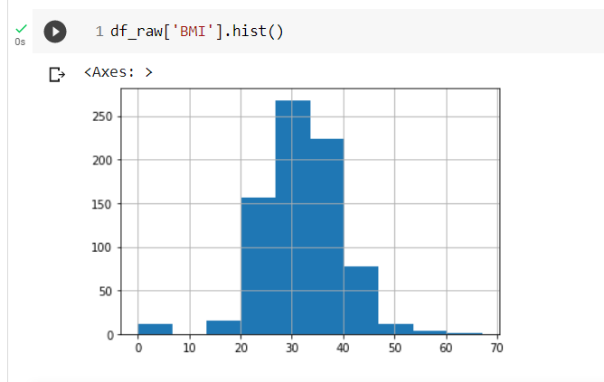
4. Create Histogram for “BMI” and “Glucose”
.hist()

Slide 10
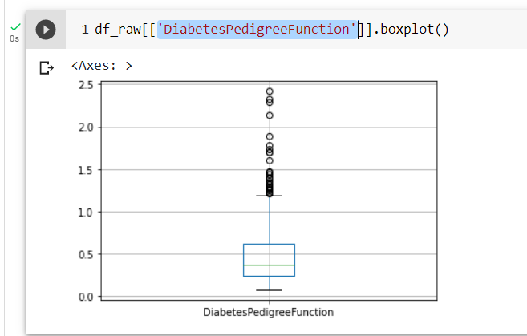
5. Create Boxplot for “DiabetesPedigreeFunction” that can be used to compare Diabetes vs non-Diabetes
.boxplot()

Slide 11
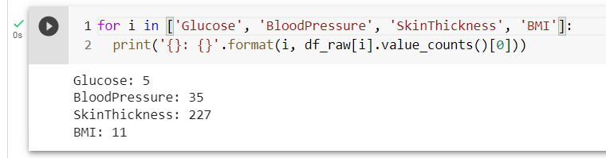
6. "Glucose", "BloodPressure", "SkinThickness", "BMI" contain 0. show how many row of each column that have value equal to 0
.value_counts()

Slide 12
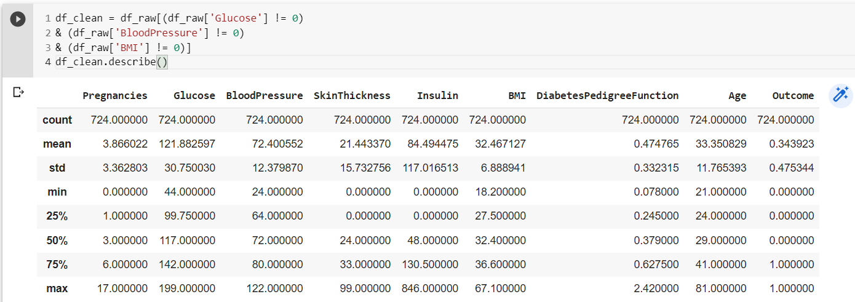
7. "Glucose", "BloodPressure", and "BMI" have few 0. Drop rows which have 0 in any of these column.

Slide 13
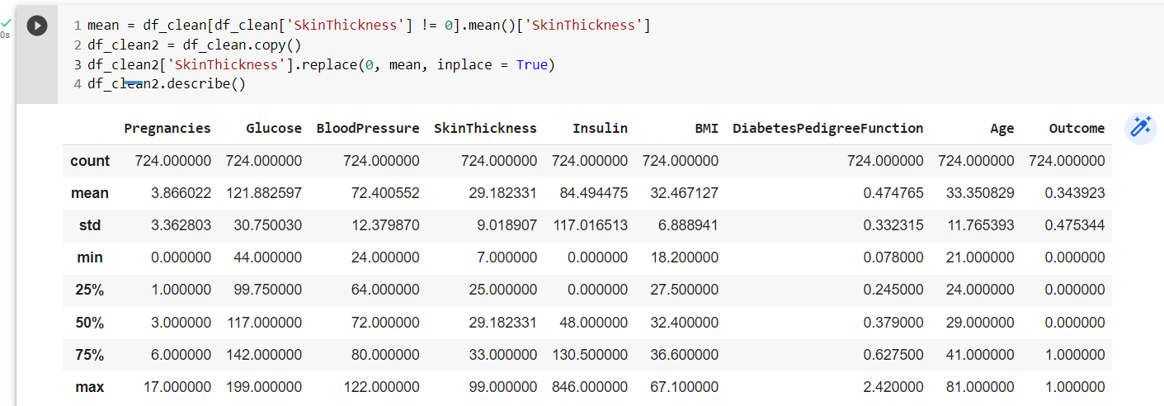
8. "SkinThickness" have many 0. Impute rows in this column that equal to 0 with the mean (without 0).

Slide 14
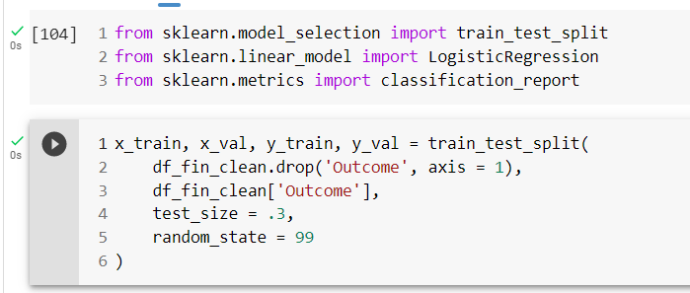
9. Separate the predictors from the target variable and split the dataset into training and validation sets
train_test_split()

Slide 15
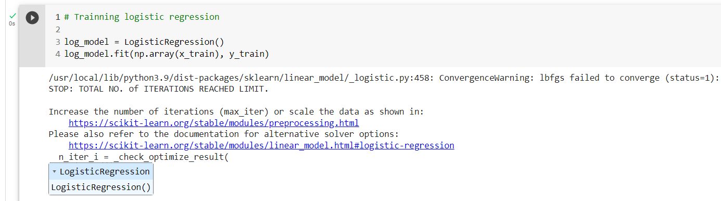
10. Train logistic regression
LogisticRegression()

Slide 16
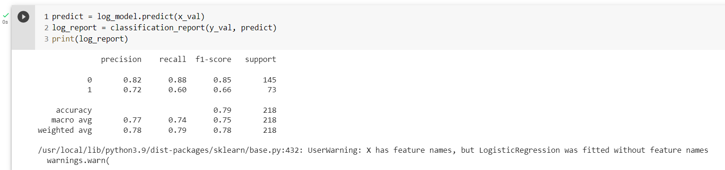
11. Show logistic model validation performance metrics
classification_report()

Slide 17
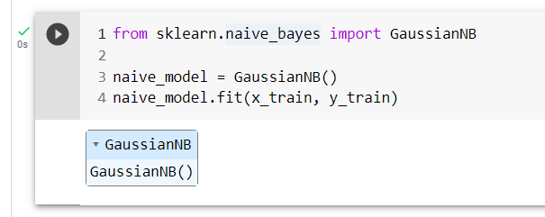
12. Train Gaussian Naïve Bayes
GaussianNB()

Slide 18
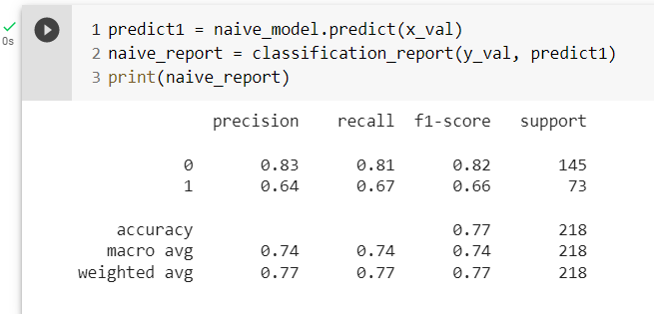
13. Show NB model validation performance metrics
classification_report()

Slide 19
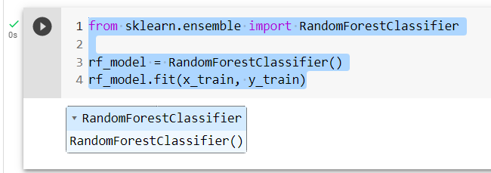
14. Train Random Forest Classifier
RandomForestClassifier()

Slide 20
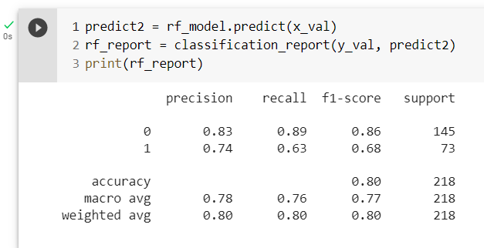
15. Show RF model validation performance metrics
classification_report()

Slide 21
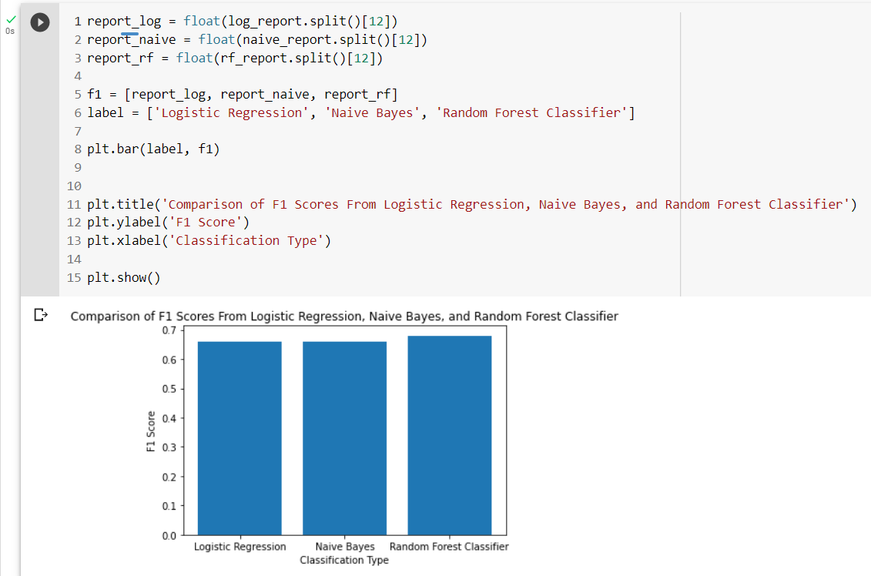
16. Create Bar plot that compare validation F1-score from logistic, NB and RF model

